Slide 1
Year 10 Work Experience Information Evening
Dates for Year 10 Work Experience: 7-11 July 2025

Slide 2

Careers Guidance
At Houlton School we have the highest expectation of our pupils and their potential.
We recognise that Careers Education, Information, Advice and Guidance (CEIAG) makes a significant contribution to preparing pupils to take their place as suitably qualified and responsible adults within society, who can make informed choices and achieve personal and economic wellbeing throughout their lives.
CEIAG will enable all pupils to develop key employability and enterprise skills which are highly valued by employers, colleges, universities and apprenticeship providers.

Slide 3

Building skills for the future
One of the reasons we focus so heavily on the LORIC Curriculum at Houlton is because we know that academic performance is only one of the areas of currency that pupils will need to be successful in their future career choices.
Employers are looking for skills and attributes in addition to academic qualifications and part of our curriculum is designed to teach pupils these skills and help them identify for themselves areas which they need to develop.
Work experience is an excellent opportunity to not only demonstrate these skills to a potential future employer, but also to identify areas that pupils need to work on prior to making their post 16 choices.

Slide 4
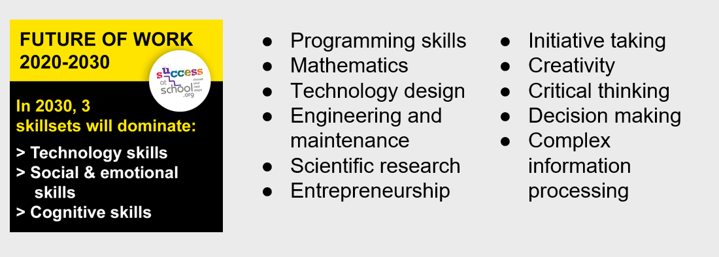
Changes in employment sectors
Experts say that we are currently living through a fourth industrial revolution with a rapid change in the way in which we work, and the skills needed.

Slide 5
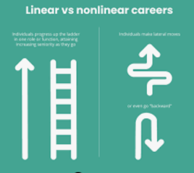
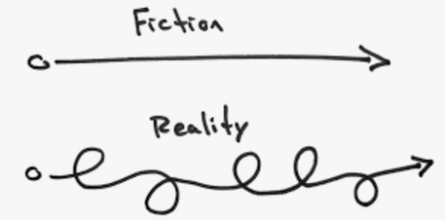
Linear vs non-linear careers are increasingly common in Global employment data

Slide 6

Life skills required for the workplace
Good communication
Motivation and initiative
Leadership
Reliability/dependability
Following instructions
Teamwork
Patience
Adaptability
Emotional control
Resilience

Slide 7
Why do pupils do work experience?
Develop transferable skills e.g. communication and teamwork
Understand how organisations work or experience first hand a job they are interested in
Building confidence in interacting with adults
Confirming an interest in a career or (equally useful!) deciding it is not for them
A foot in the door - if they impress the employer they may be asked back on a more formal arrangement such as an internship, or encouraged to apply when vacancies arise
Providing valuable content for a UCAS personal statement, apprenticeship application or for part-time employment whilst studying

Slide 8

Where will work experience take place?
We are asking your child to find their own placement.
The date for Year 10 Work Experience week is Monday 7 - Friday 11 July 2025.
Pupils have stared considering this already as part of our Personal Development Curriculum.
Although they may have a placement with you or a family member, we do ask that during the week they must work with other adults and not be based with a sole trader for safeguarding reasons.

Slide 9

Possible options…
It doesn’t matter if a placement cannot be found in the exact field that pupils may want to enter into - all workplace experiences will help to develop key employability skills and a valuable experience of what it is like to go to work!
Primary schools Nurseries
Retail Shops Restaurants/cafes
Companies Animal Shelters
Solicitors Garages
Agricultural Sports / Equine
Hairdressers Trades
The list is endless

Slide 10

Check List
1. Pupils starting point is listing possible fields of work and potential places they might wish to go.
2. Pupils need to contact the employers / places they may like to go on work experience – an initial call or visit works well followed up with a formal email from the pupil.
3. Once a placement is confirmed, the Google Form document that will be shared with you needs to be completed.
4. Once the appropriate checks have been completed we will confirm the placement.
5. Whilst on work experience we will either call or visit to check how pupils are doing.
6. Following the return from the placement an extensive reflection activity will take place to support pupils in making the most out of their experience.

Slide 11

Health and Safety
Once we have been given the detail of placements, our external verifiers will check that the placement is safe for pupils.
Risk assessments and employer insurances are checked thoroughly before the placement is approved.
If we have any concerns, we will speak with both yourselves and the employers to see if these can be resolved.

Slide 12

Is work experience compulsory?
Work experience is part of our Personal Development Curriculum and is compulsory for all pupils.
Where pupils are struggling to find a placement, or do not seek one for themselves we will either place the pupils ourselves, or peoples will undertake online work experience for the duration of the week.
Work experience placements can become very popular so we advise that pupils are planning and seek out placements as soon as possible.

Slide 13

What’s next?
Pupils should now be actively searching for a placement.
Prior to the Christmas holidays we will be sharing with you a Google form to be completed which will give us all the information we require to thoroughly check the placements which pupils are planning to attend.
There will be a section of the form to be completed by pupils and also a sign off section which will need to be completed by parents/carers.
This form should be completed as soon as a placement is found and at the latest by the deadline indicated on the form.
Ideally we would like all pupils to have secured their work experience placement by February half term.

Slide 14
FAQs
Can the placement be out of county?
I run a business - can my child do work experience with me / a family member?
My child has additional needs, how will they be supported during work experience?
My child is struggling to find any work experience in the area which they are interested, what should we do?
Are there any placements which pupils are not permitted to undertake?
My child has secured work experience but it is during the summer holidays, what should they do during the work experience week?
Who should l contact if l have questions or concerns about work experience?
Who is externally verifying the safety of the placement my child finds?

Slide 15
Thank you
Please stay behind if you have any questions

